Slide 1


Mini Project
CSE2015 DATA ANALYSIS AND VISUALIZATION
YOUTUBE ANALYSIS
VATHSALA B S (20211CAI0203)
PRANAV GANESH (20211CAI0062)
SUHAS K (20211CAI0057)

Slide 2
ABSTRACT
YouTube is one of the leading data streaming platforms where many people share and watch content.
It generates a huge amount of data every single second.
have some data missing and a lot of hidden insights
In our project, we have applied some of the data processing techniques to eliminate the missing values and have performed data visualization to discover some insights about the platform.
The insights obtained from the visualization are useful for discovering what topics are trending and what people are watching more often so that the recommendation system of YouTube can be improved.
Our project aims to discover new insights about the platform and implement them to improve the user experience so that the users get the best experience compared to the rival platforms.
Notes:
YouTube is one of the leading data streaming platforms where a lot of people share and watch content. This platform has a lot of content creators who share videos of various kinds in various formats and generate a huge amount of data every single second. A platform with such a high user base and generating huge amounts of data will have some data missing and a lot of hidden insights that may be useful for decision-making. In our project, we have applied some of the data processing techniques to get rid of the missing values and have performed data visualization to discover some insights about the platform. The insights obtained from the visualization are useful for discovering what topics are trending and what people are watching more often so that the recommendation system of YouTube can be improved. Our project aims to discover new insights about the platform and implement them to improve the user experience so that the users get the best experience when compared to the rival platforms.

Slide 3
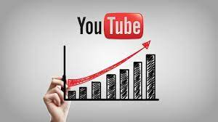
PROBLEM STATEMENT
Improve the recommendation system of YouTube
Increase the viewer base of YouTube
Notes:
We are addressing the problem of increasing the viewer base and the recommendation system of YouTube. By performing Data Analysis and Visualization we are discovering insights that will help us understand the user's behavior so that we can gain more viewers and improve the recommendation system of YouTube.

Slide 4
TOOLS USED
Software:
Google Colab: Colaboratory allows us to write and execute Python codes in our browser.
Libraries:
NumPy
Pandas
Seaborn
Matplotlib
Wordcloud
Hardware: Dell Inspiron 15 Laptop: Processor 11th Gen Intel(R) Core(TM) i5-11320H @ 3.20GHz ,16 GB RAM ,Windows 11 Home
Database: Global YouTube Statistics

Slide 5
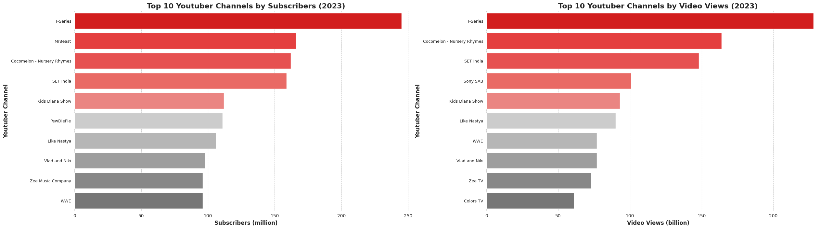
OUTCOMES
Figure 1a: Bar Chart Showing the Top 10 YouTube Channels by number of subscribers
Figure 1b: Bar Chart Showing the Top 10 YouTube Channels by number of views

Slide 6
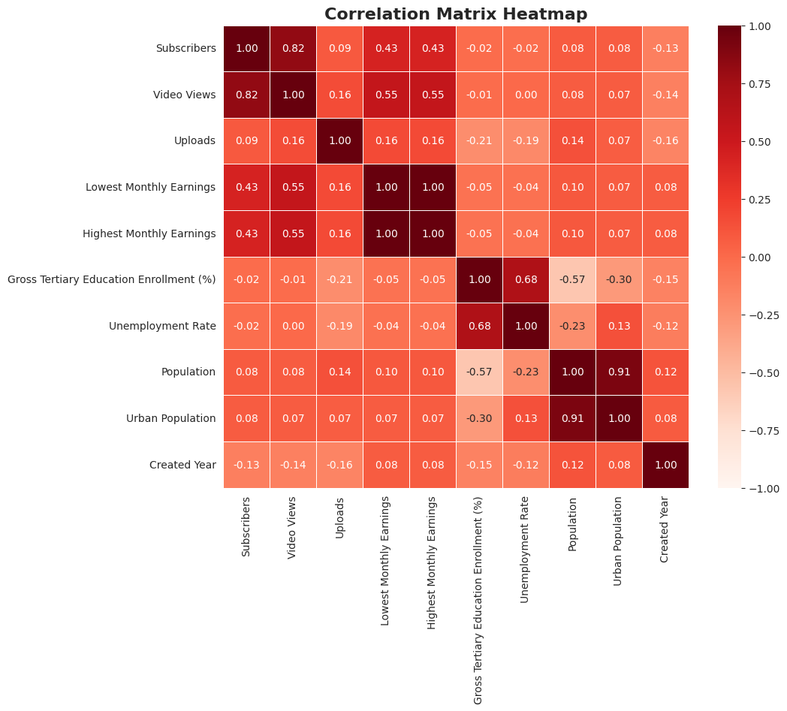
OUTCOMES
Figure 2: Heat Map showing the correlation between the Variables

Slide 7
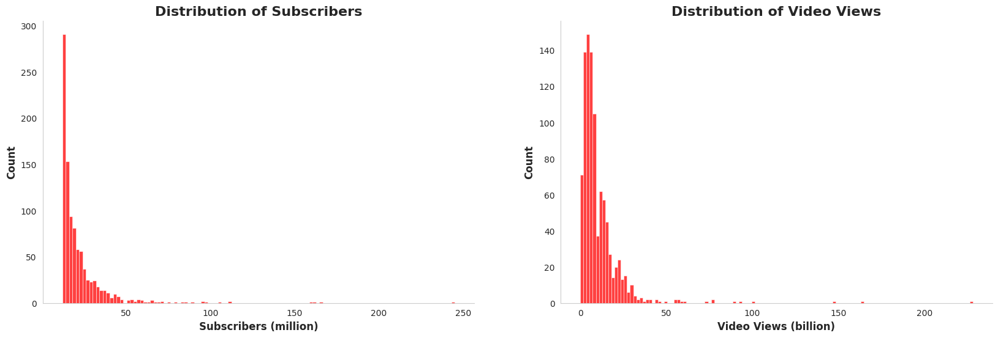
OUTCOMES
Figure 3a: Histogram of Channel Subscribers
Figure 3b: Histogram of Channel Views

Slide 8
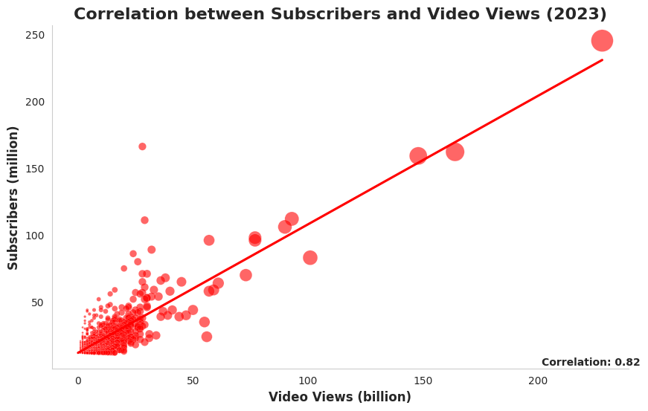
OUTCOMES
Figure 4: Scatter Plot showing the correlation between Subscribers and Video Views

Slide 9
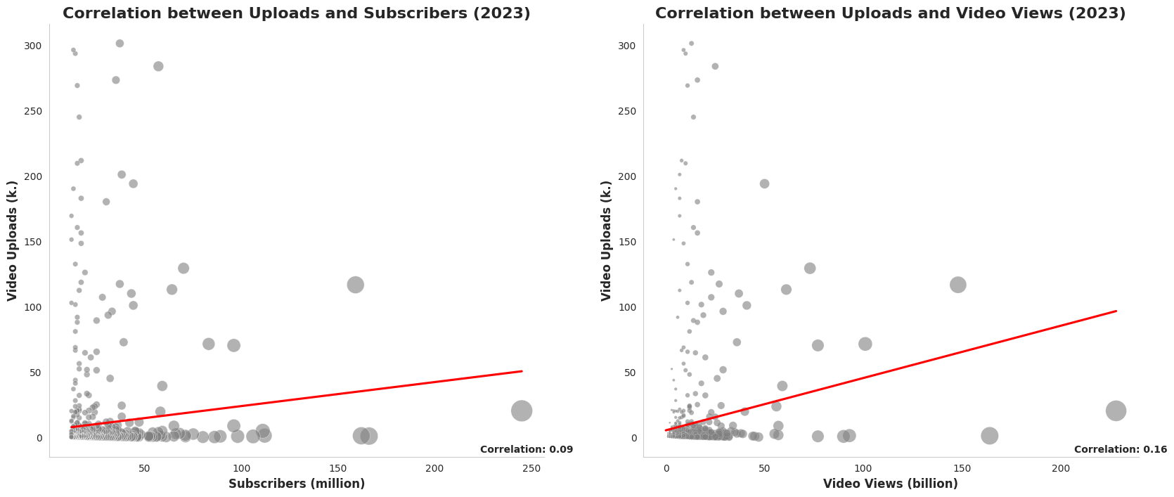
OUTCOMES
Figure 5a: Scatter plot showing the correlation between Subscribers and Video Uploads
Figure 5b: Scatter plot showing the correlation between Video Views and Video Uploads

Slide 10
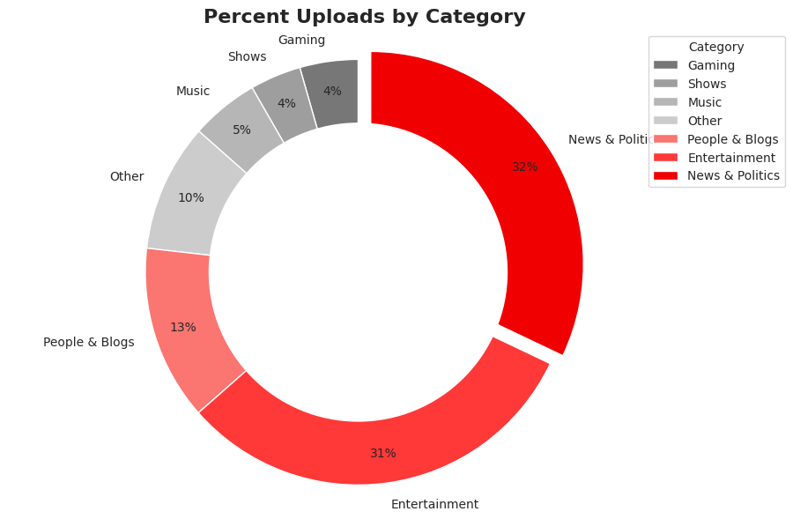
OUTCOMES
Figure 6: Pie Chart Showing Category Wise Video Uploads

Slide 11
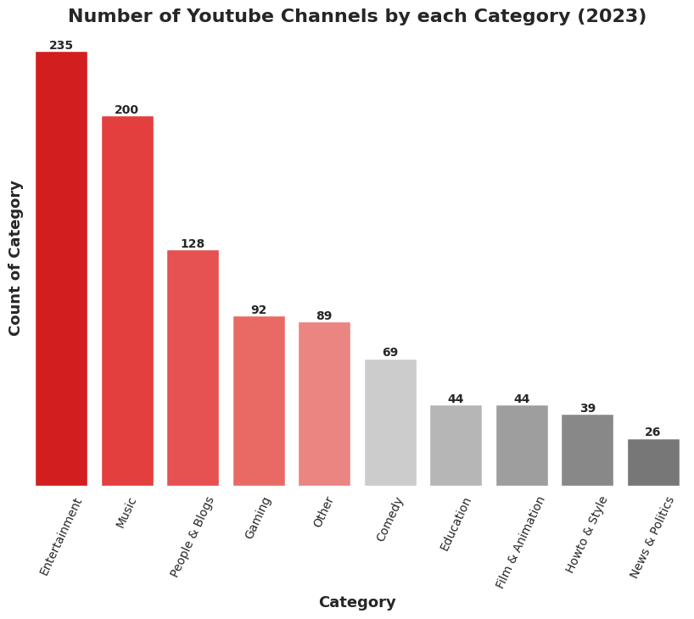
OUTCOMES
Figure 7: Bar Chart showing the Categories with the highest no channels in 2023

Slide 12
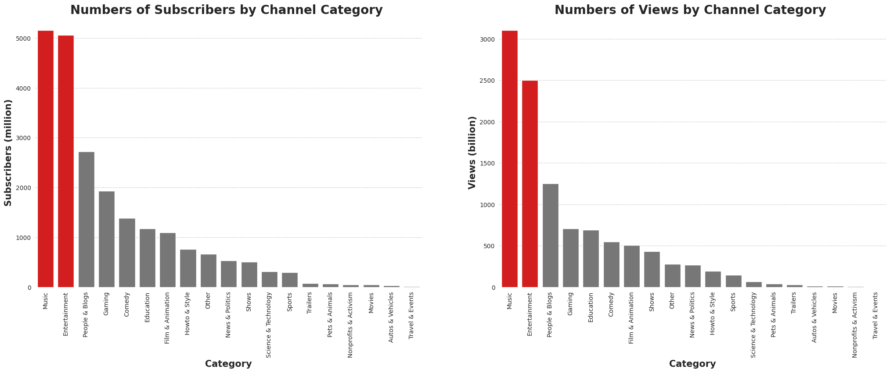
OUTCOMES
Figure 8a: Bar Chart showing the number of subscribers of channels category-wise
Figure 8b: Bar Chart showing the number of views of channels category-wise

Slide 13
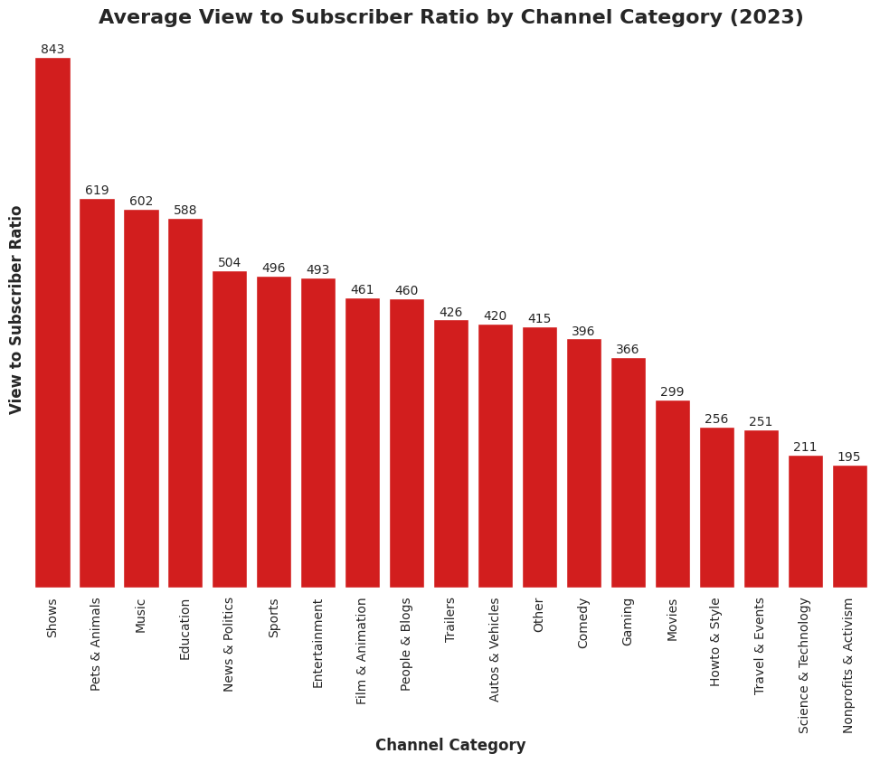
OUTCOMES
Figure 9: Bar Chart showing the view-to-subscriber ratio of channels category-wise

Slide 14
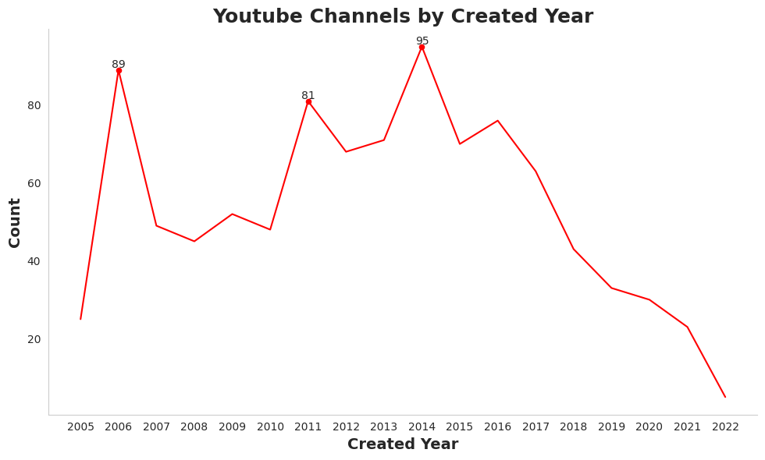
OUTCOMES
Figure 10: Line plot showing the trend in the creation of YouTube Channels.

Slide 15
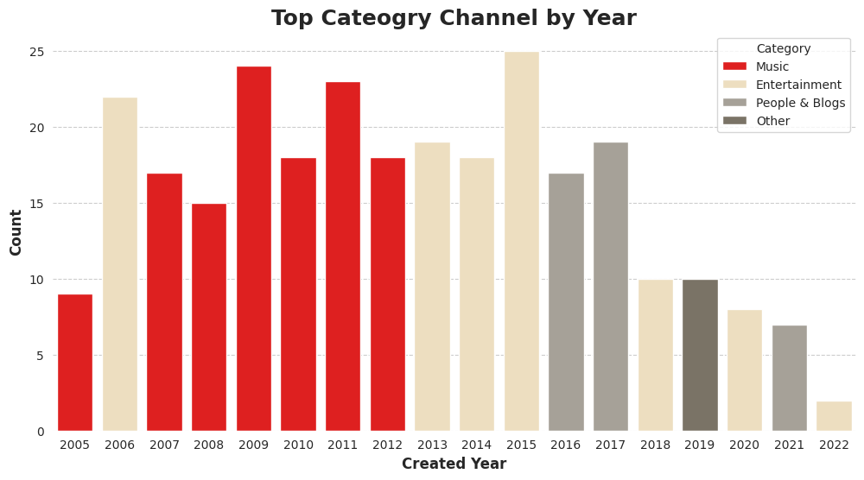
OUTCOMES
Figure 11: Bar Plot showing the creation of YouTube Channels Category-wise

Slide 16
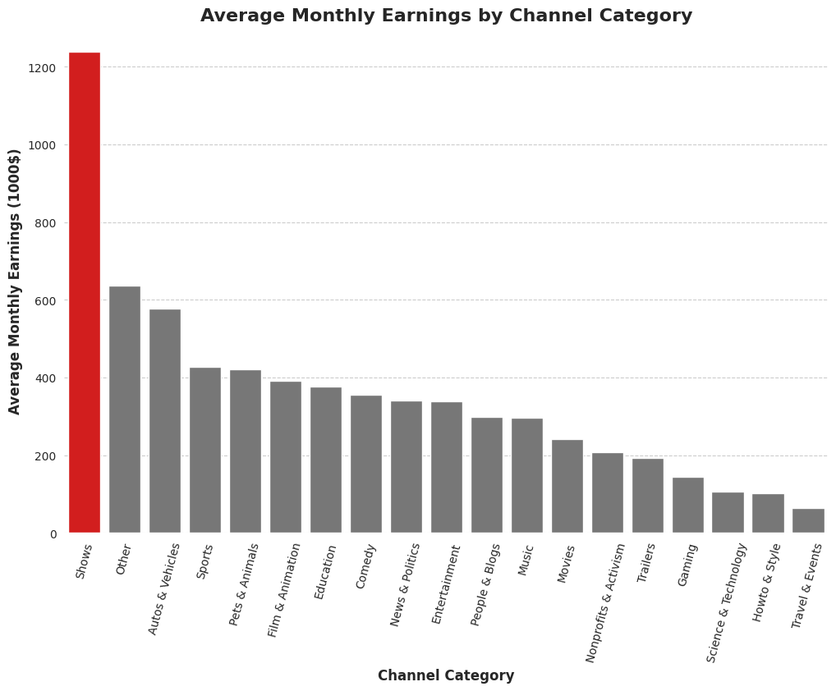
OUTCOMES
Figure 11: Bar Plot showing the category with the highest earnings

Slide 17
LIMITATIONS AND FUTURE SCOPE
The inference of the insights found has not been implemented.
All kinds of charts are not used to visualize the data
YouTube data is too vast and visualization on multiple variables have not been performed which can be done in the future
The data from YouTube is like real-time data ,so analysis results need to be performed regularly.

Slide 18
CONCLUSION
In this project, we achieved a cleaned dataset of the YouTube data which can be used for visualization.
By performing visualization we can to know about many insights about YouTube which can be used to improve YouTube as a platform.
We discovered :
the topics that are trending
the categories with the highest demand
the channel with the most number of subscribers
the video with the most views
the category with the highest revenue
the share of videos category-wise
the number of channels that are being created each year and much more.

Slide 19
CONCLUSION
All these insights are useful in making decisions for the stakeholders of YouTube and improving YouTube.
Additionally, these insights can also be used by content creators to analyze and improve their content.
We would like to conclude by saying that there is always room for improvement and by implementing the findings of this project YouTube can be improved further to improve the user experience and remain as the market leader.

Slide 20


